Slide 1

Assignment 1
Dev. Environment and Tools
Siva R Jasthi
ICS499 Software Engineering and Capstone Project
Spring 2022
Computer Science and Cyber Security
Metropolitan State University

Slide 2
Assignment 1 Overview
In this assignment, we will focus on setting up the tools and development environment ready for ICS499.
Complete the actions per the instructions given on each of the slides.
Provide the screen shots on the empty slides as indicated
Complete the checklist on the last Slide.
Submit the completed Power Point slides (the entire deck) to the Assignment 1 drop box on D2L.
For any questions or clarifications, please post a question to the D2L discussion board.

Slide 3
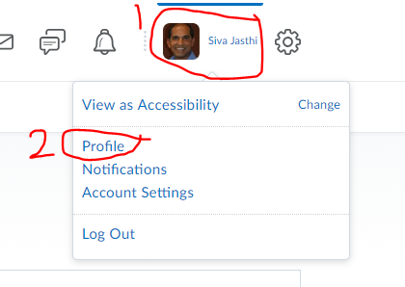
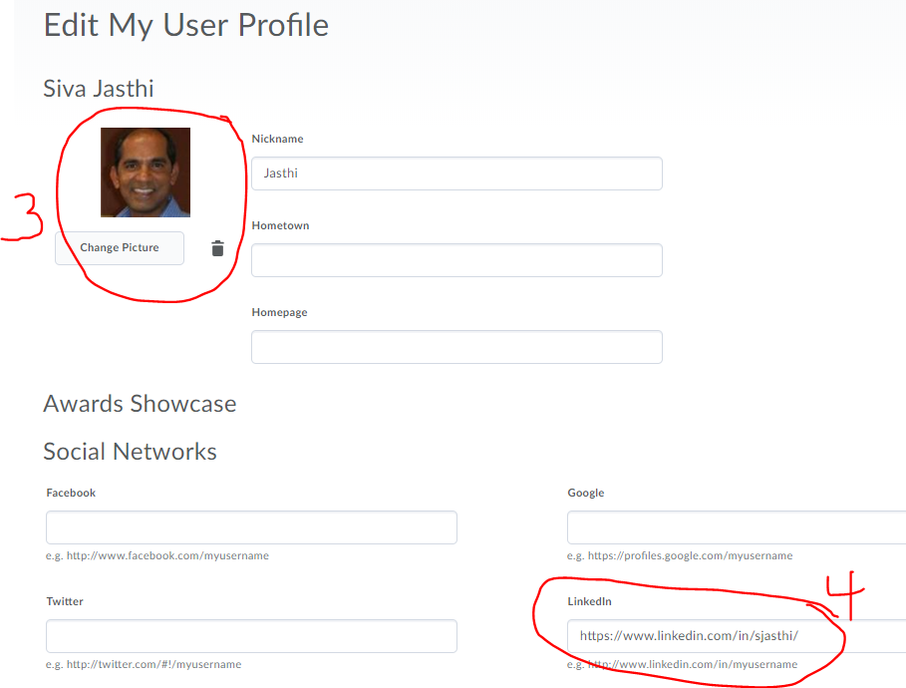
1. Setup your profile in D2L
Upload your picture to your profile
Input your linkedin profile (if you have one)

Slide 4
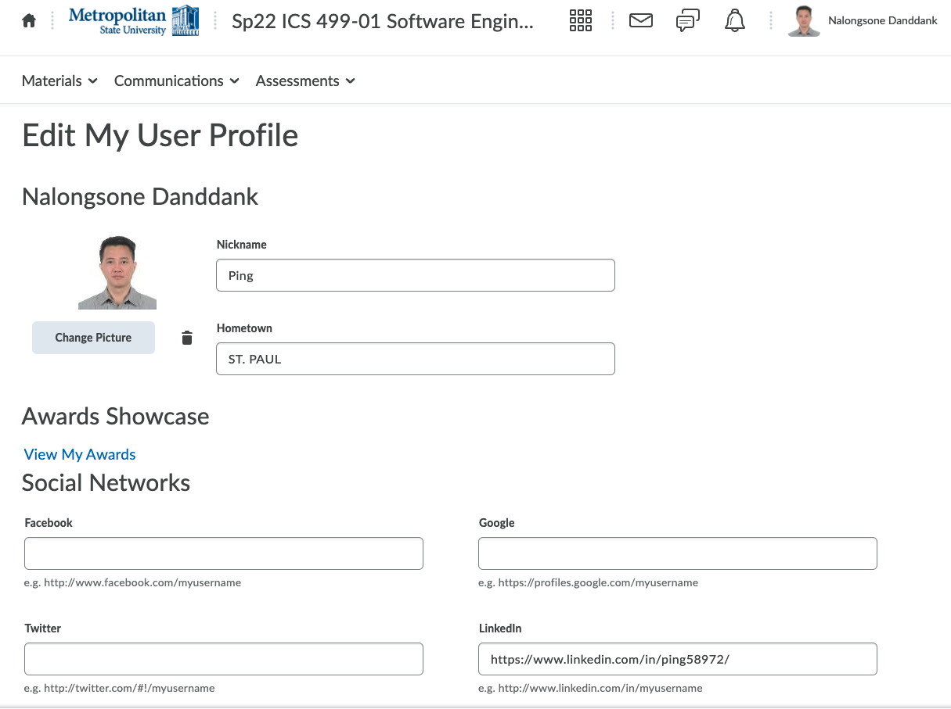
Screen shot of your D2L profile
https://www.linkedin.com/in/ping58972/

Slide 5
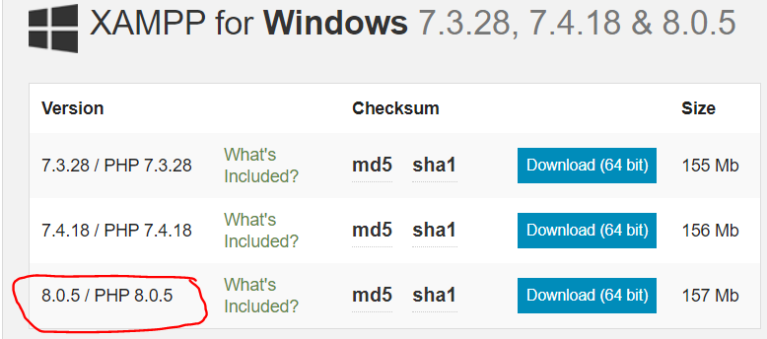
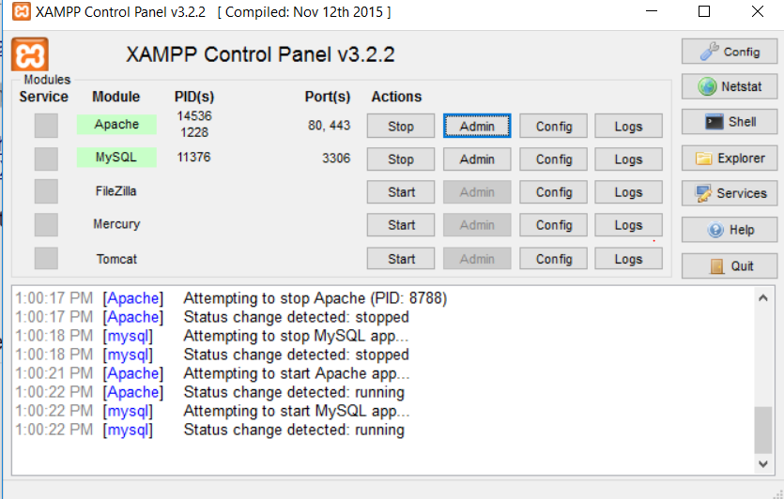
2. Install XAMPP 8.1.1
1. Download XAMPP 8.1.1 from
https://www.apachefriends.org/download.html
2. For installation issues and trouble shooting, please refer to
(Video) https://www.youtube.com/watch?v=CGhzCOOEUJU
(Wiki) https://www.wikihow.com/Install-XAMPP-for-Windows
3. After successful installation and starting Apache, access this link on your browser to see the PHP configuration.
http://localhost/dashboard/phpinfo.php
4. Submit a screen shot of what you see on the browser on the next slide.
Install XAMPP
Start XAMPP
Click “Start” for Apache
Access http://localhost

Slide 6
XAMPP Deployment Issues
(Windows and Mac Users) You may get Port conflict issues. Search StackOverFlow or google the error message to figure out how to resolve those issues.
(MAC Users) There were two issues:
1. Site returning an access privilege denial
To solve this make sure rebus file has at least "read" privileges for everyone on your computer. Right click on file, get info, and at bottom give everyone "read" access.
2. When entering link in URL, site downloads files and does not display them.
Try copying all files inside your deployment directory (do not just duplicate the directory) and create a new directory with the copied files. The issue may be coming from hidden files.

Slide 7
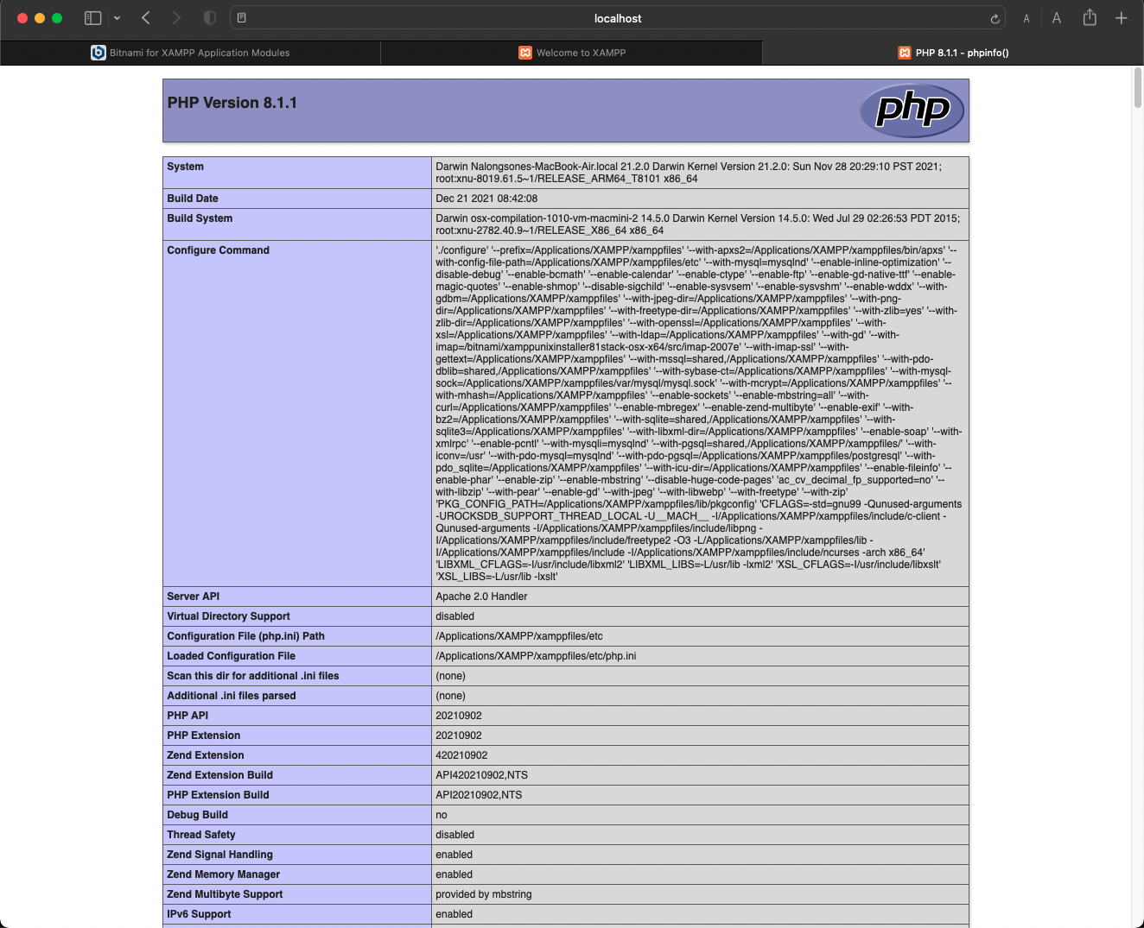
Screen shot of XAMPP http://localhost/dashboard/phpinfo.php

Slide 8
3. Install Eclipse IDE (for Java Coding)
We will be using Eclipse as our code editor for writing Java programs.
Check one of the following:
[ X] I have installed Eclipse and I plan to use it in ICS499
[ ] I did not install Eclipse as I want to stick with another editor I am already familiar with

Slide 9
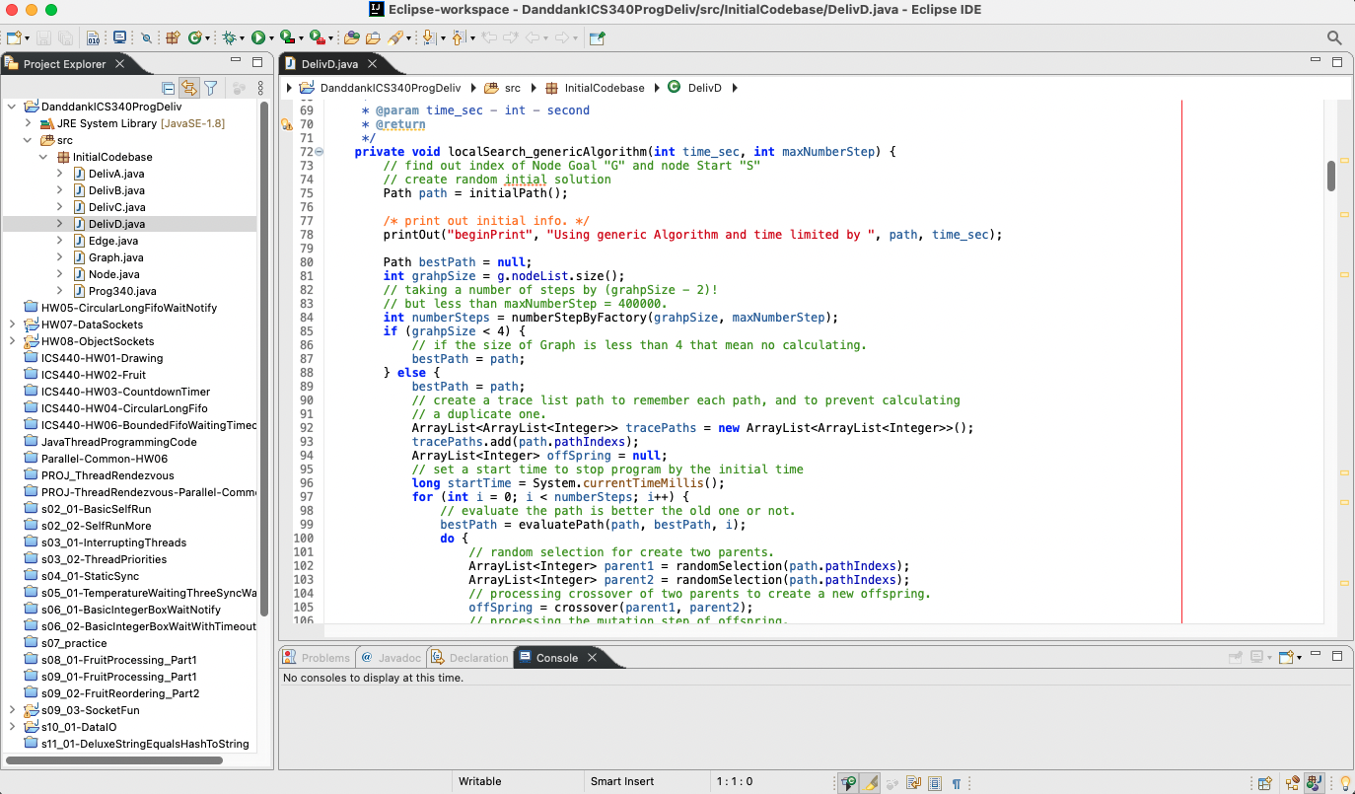
Screenshot of Eclipse or the editor you want to use

Slide 10
4. GitHub
Go to https://github.com/ and create an account using your metrostate email address.
We will be using GitHub to version control our assignments and projects (details to be provided later).
What is your github username? ping58972
Submit a screenshot of your github profile on the next slide
https://github.com/ping58972

Slide 11
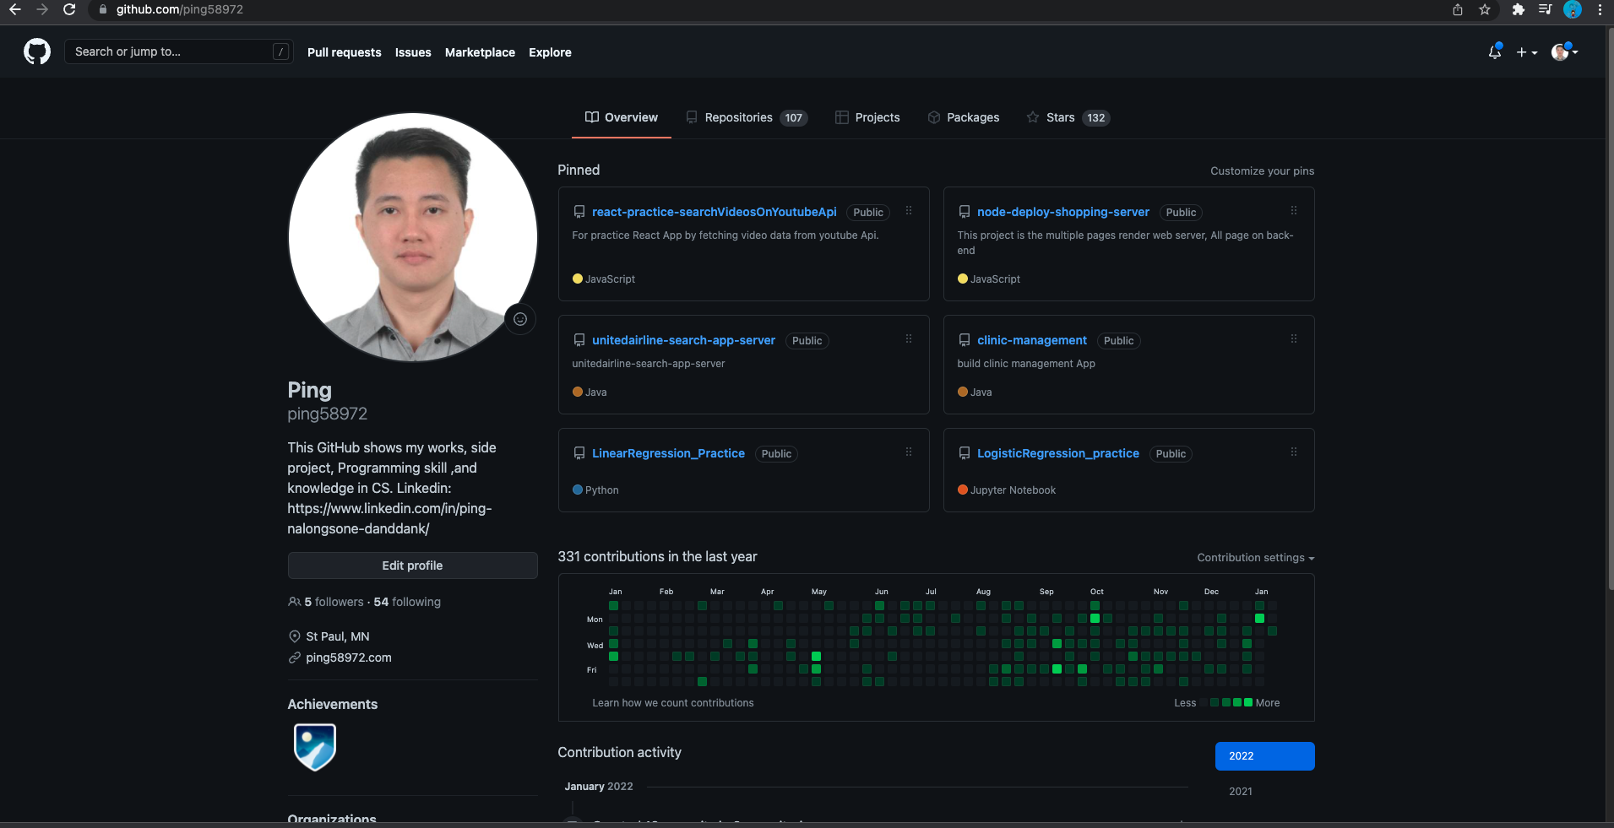
Screen shot of GitHub profile

Slide 12
5. trello
Go to https://trello.com/ and create an account using your metrostate email address.
We will be using trello to do project management using agile process. We will use trello only for the final projects (details to be provided later).
Note: I will be sending your metro email to trello tech support. They will upgrade it to professional account. If you use your personal email, then you will only be at a basic free version.
What is your trello username? nalongsonedanddank
Submit a screenshot of your trello profile on the next slide
https://trello.com/nalongsonedanddank

Slide 13
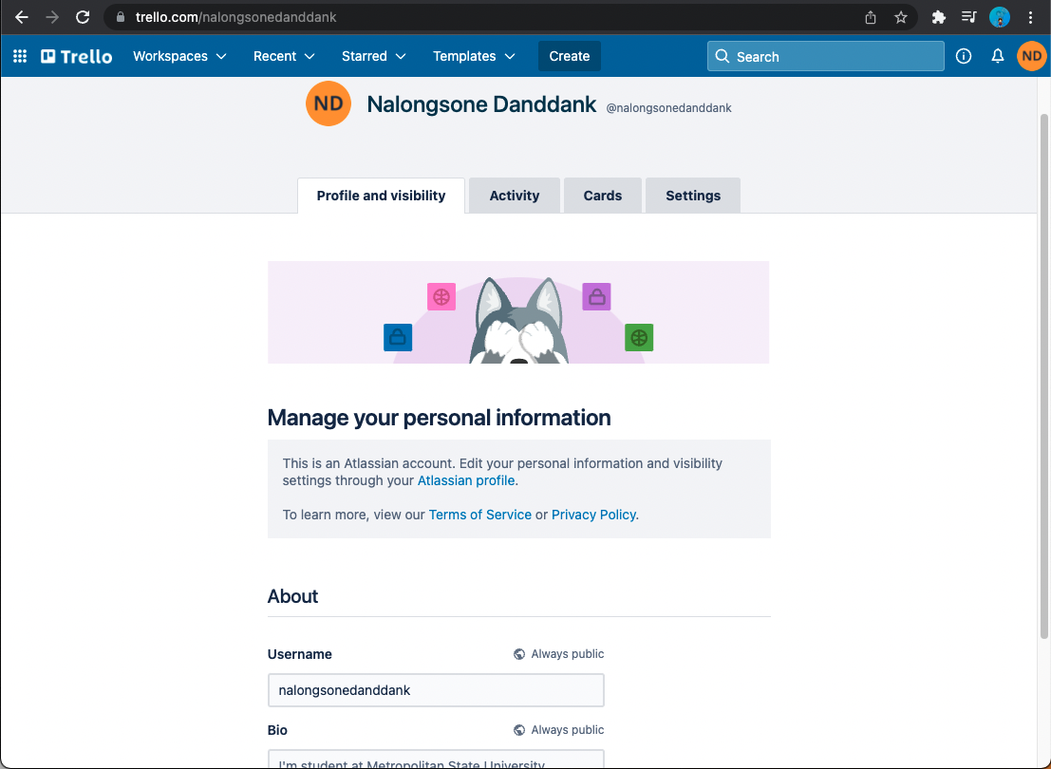
Screen shot of trello profile

Slide 14
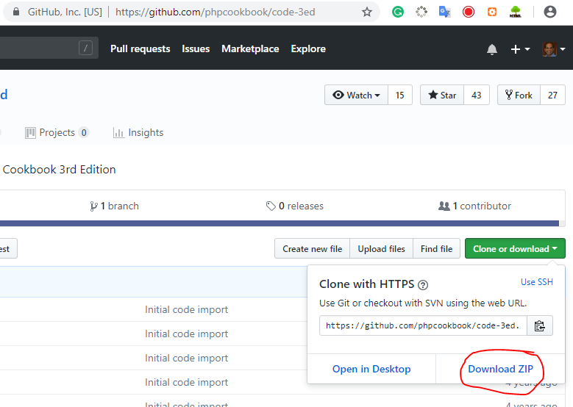

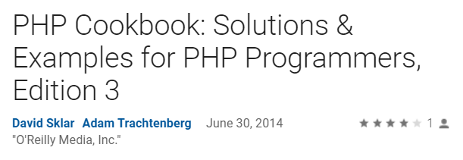
6. PHP Cookbook 3rd Edition
Download PHP Cookbook from this link
https://github.com/phpcookbook/code-3ed
Extract the contents of this ZIP file to <XAMPP/htdocs> directory.
Provide a screenshot for this link
http://localhost/code-3ed-master/09_forms/getpost.php
Note: There is no need to buy this book.

Slide 15
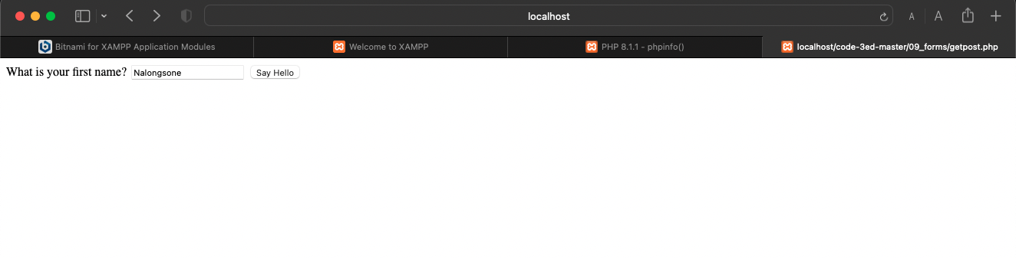
Screen shot of http://localhost/code-3ed-master/09_forms/getpost.php

Slide 16
7. Deploy Anaconda Navigator
Go to https://www.anaconda.com/products/individual
Deploy Individual edition

Slide 17
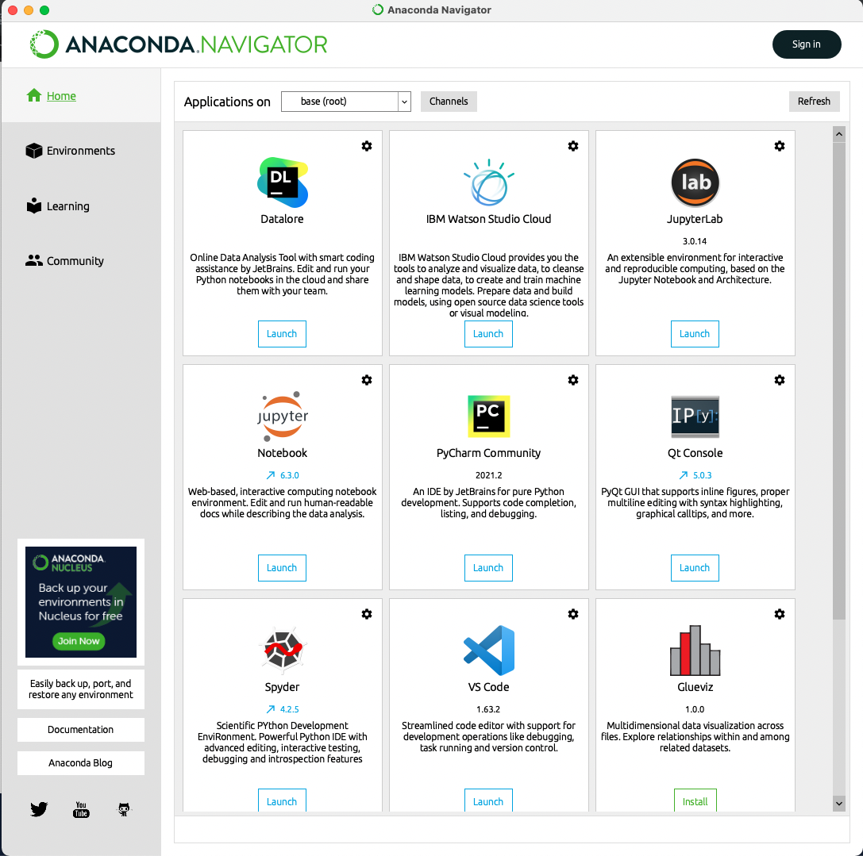
Screen shot of your Anaconda Navigator

Slide 18
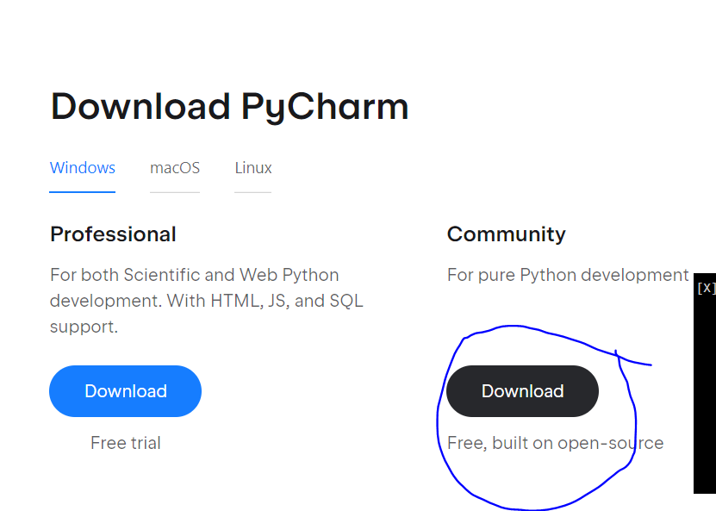
8. Deploy PyCharm (python coding)
Visit https://www.jetbrains.com/pycharm/download/#section=windows
Download “Community Edition” of PyCharm

Slide 19
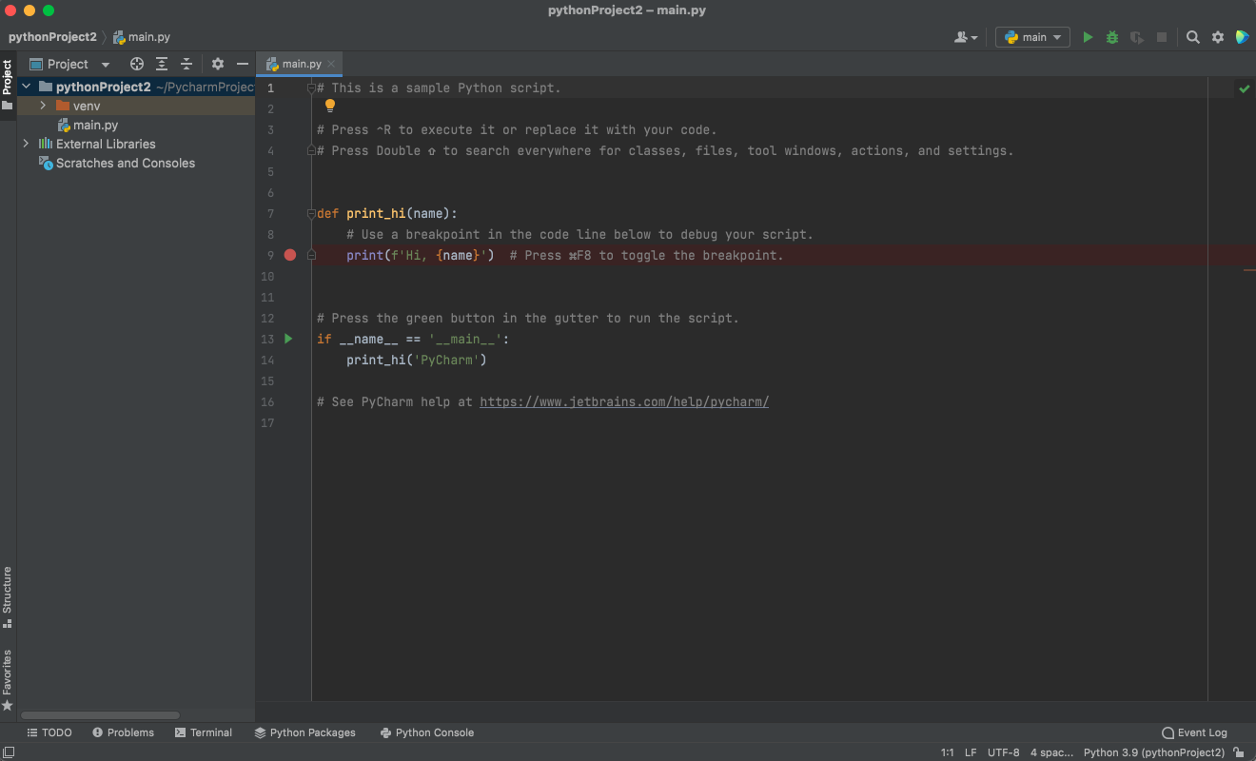
Screen shot of PyCharm IDE you installed
While exploring the web development technologies or How to .guides, identify something new learned. Include a link and screen shot.

Slide 20

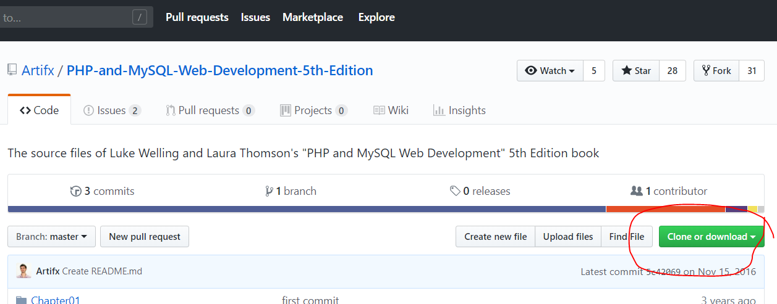
9. Download the source code (for the book)
from GitHub
https://github.com/Artifx/PHP-and-MySQL-Web-Development-5th-Edition
Extract the contents to your <XAMPP/htdocs directory
Book for preview: https://www.pdfdrive.com/php-and-mysql-web-development-e34502861.html

Slide 21
10. Take the Survey
https://www.surveymonkey.com/r/H3CF8PR
Take this survey.
There is no need to attach any screen shot.
Once you submit the survey, I will get notified.

Slide 22
Summary: Please complete this checklist
Item | Completed | Comments
1. Setup the profile in D2L | [X] Yes [ ] No
2. Installed XAMPP | [X] Yes [ ] No
3. Installed Visual Code | [X] Yes [ ] No
4. Signed up for GitHub | [X] Yes [ ] No
5. Signed up for Trello | [X] Yes [ ] No
6. Downloaded PHP Cookbook | [X] Yes [ ] No
7. Deploy Anaconda Navigator | [X] Yes [ ] No
8. Deploy PyCharm | [X] Yes [ ] No
10. Downloaded the source code | [X] Yes [ ] No
11. Have Taken the Survey | [X] Yes [ ] No
Complete this checklist and submit the entire PPT to D2L dropbox.

